Slide 1
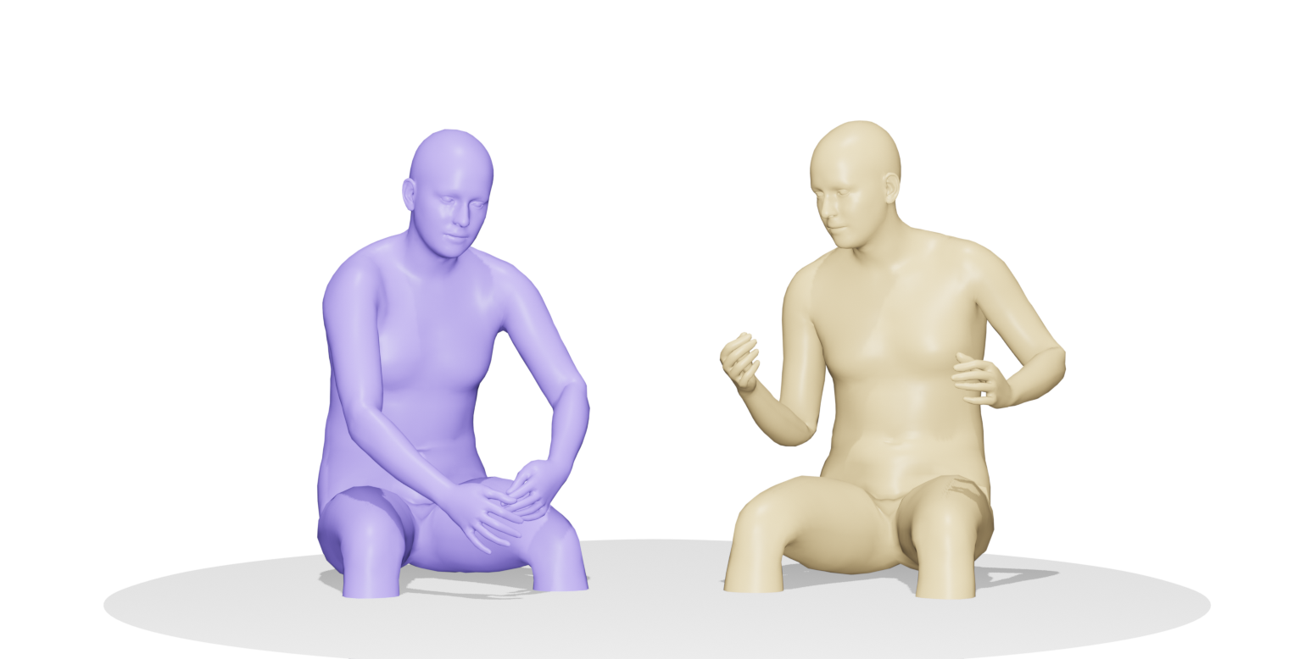
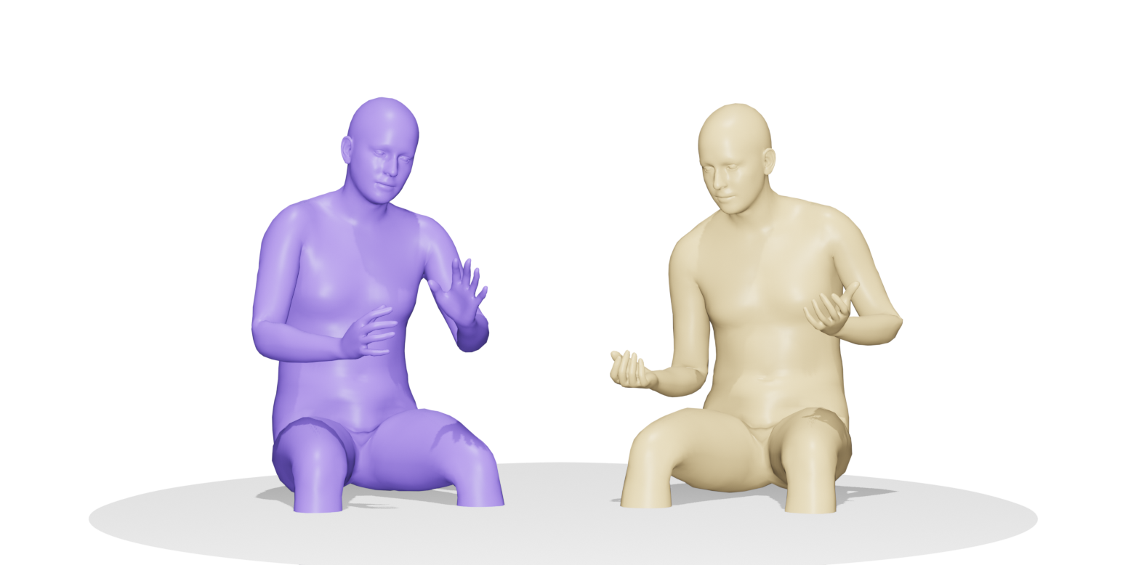
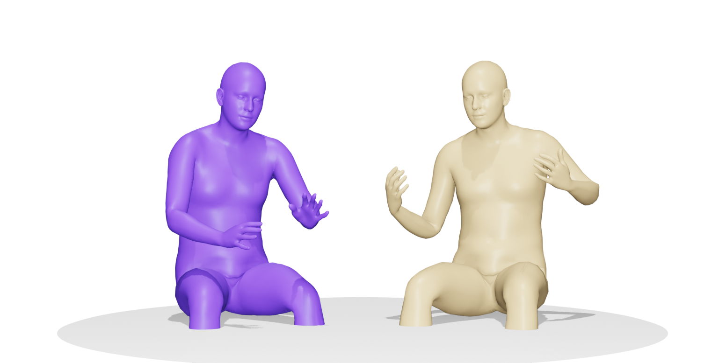
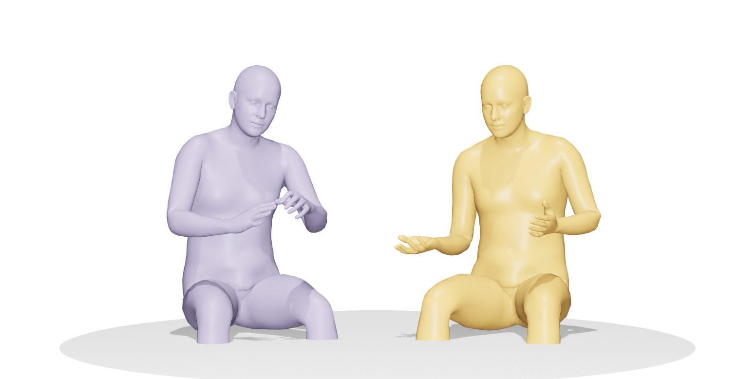
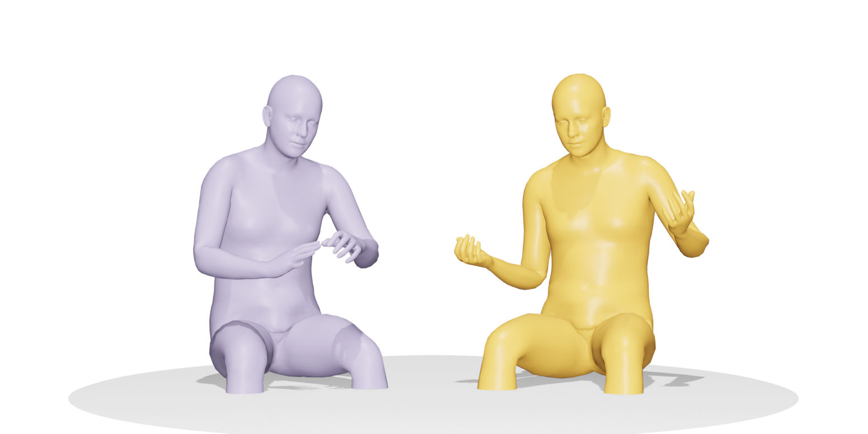
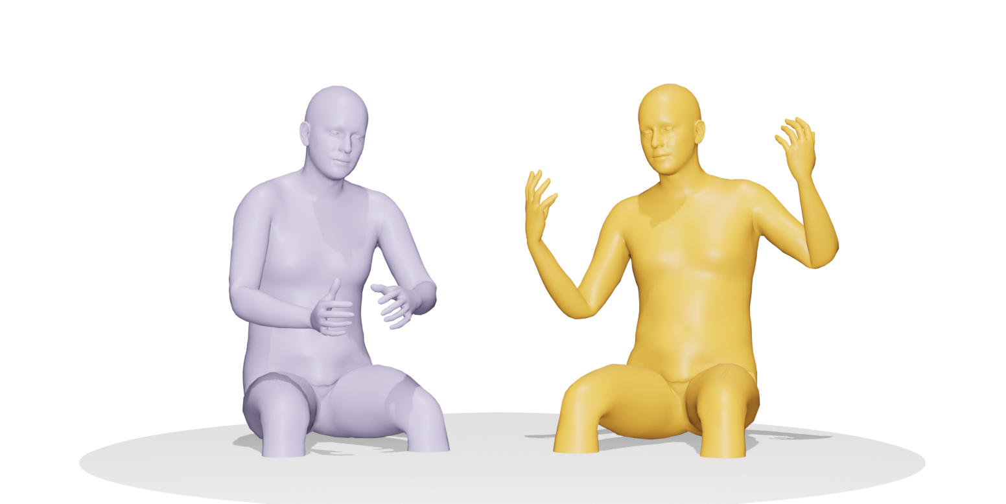
SPEAKER A (on the left):
I didn’t see that one coming.
Co³Gesture
SPEAKER B (on the right):
No, you didn’t see it coming.

Slide 2
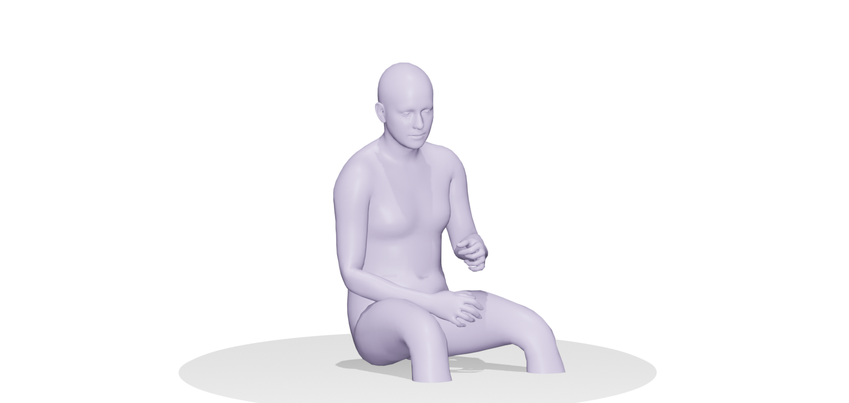
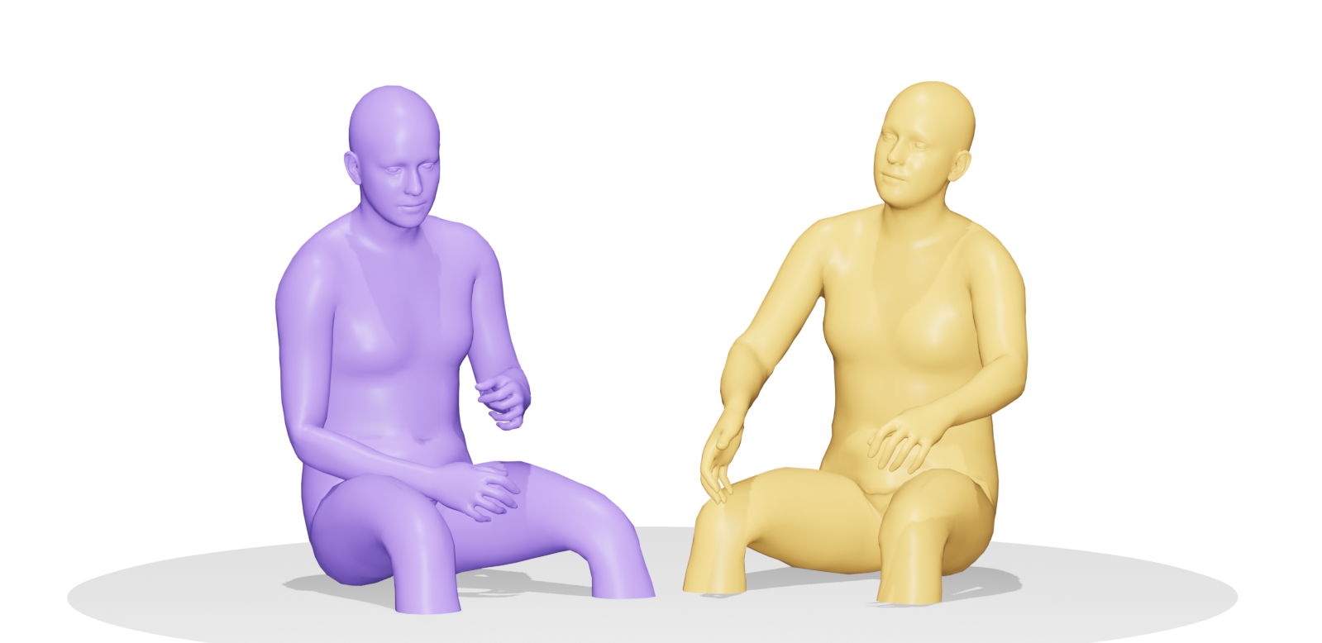
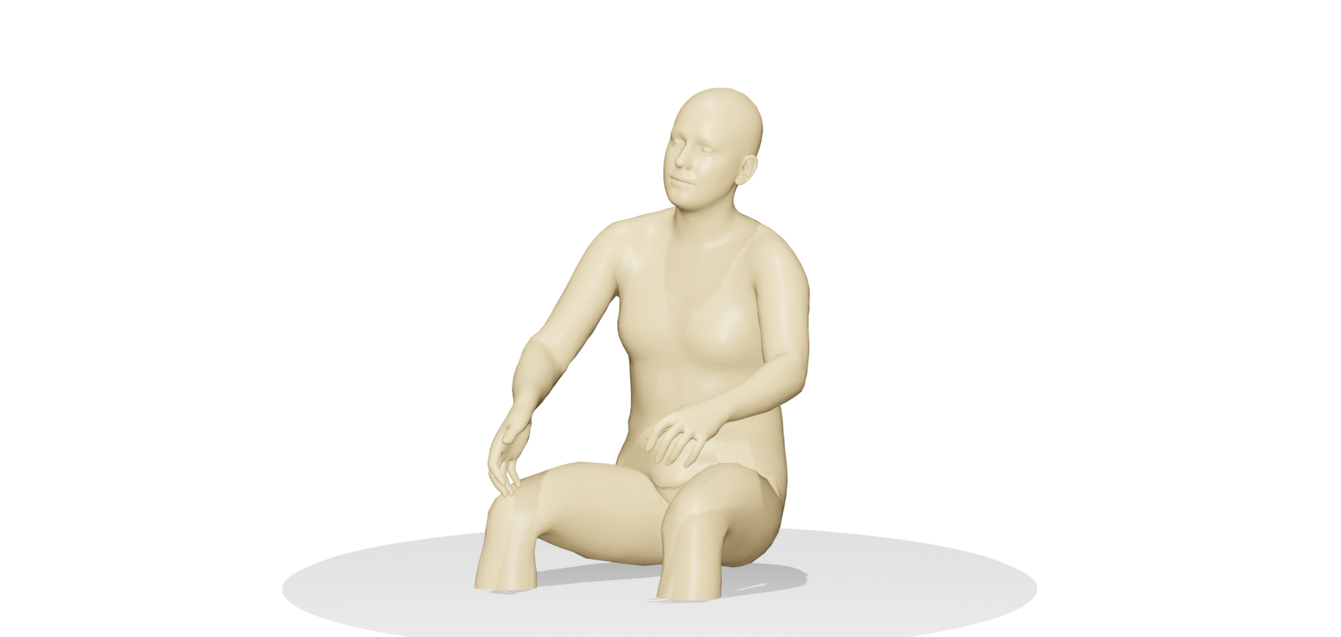
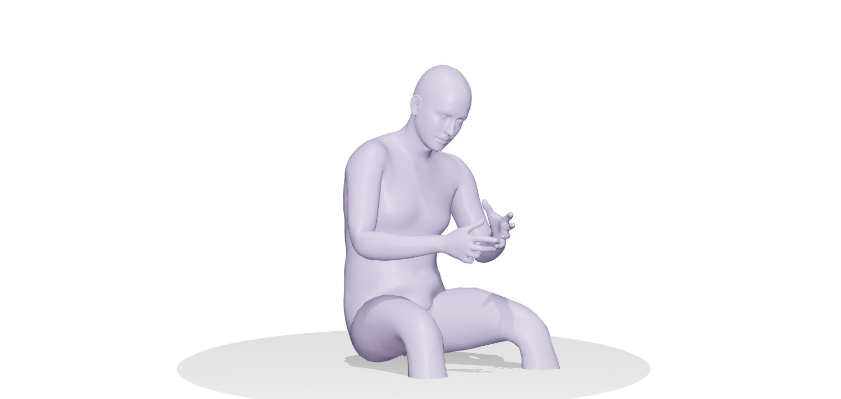
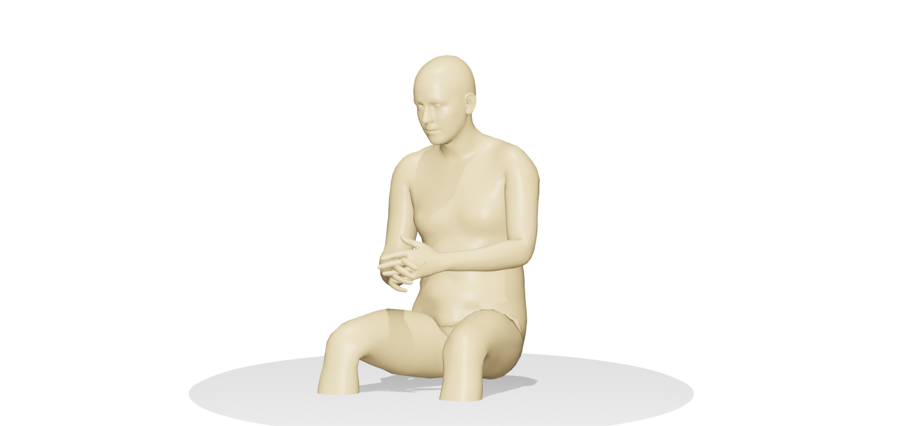
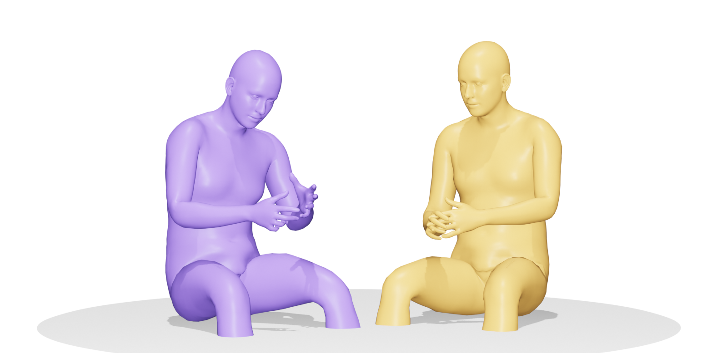
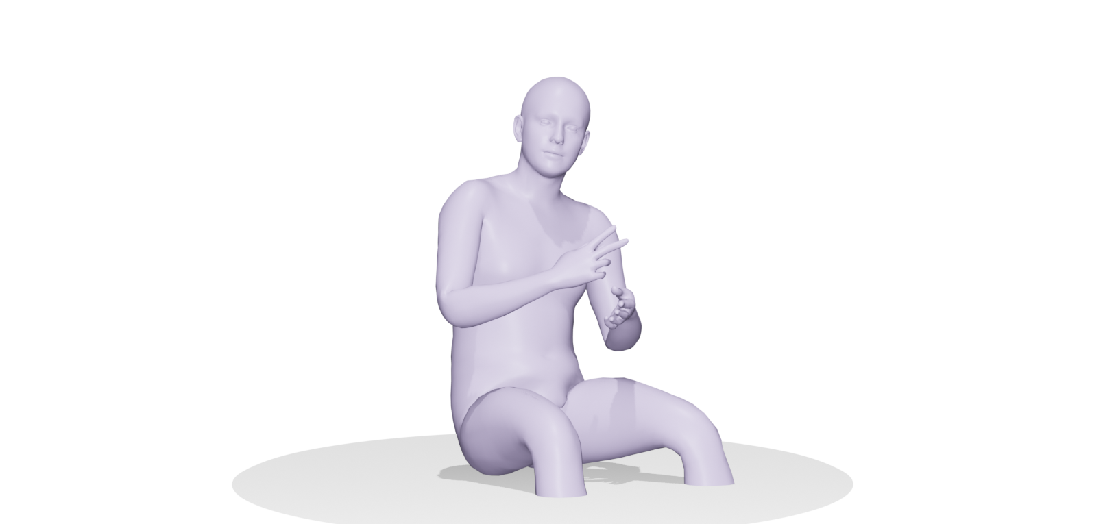
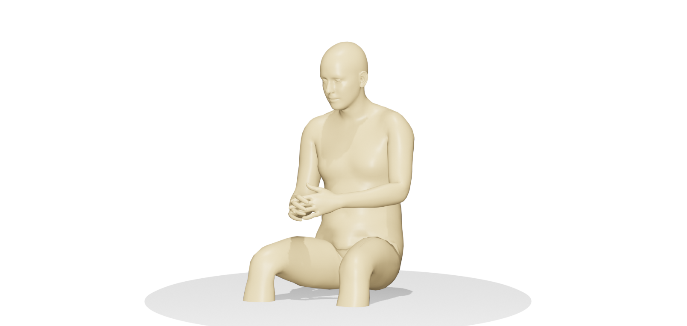
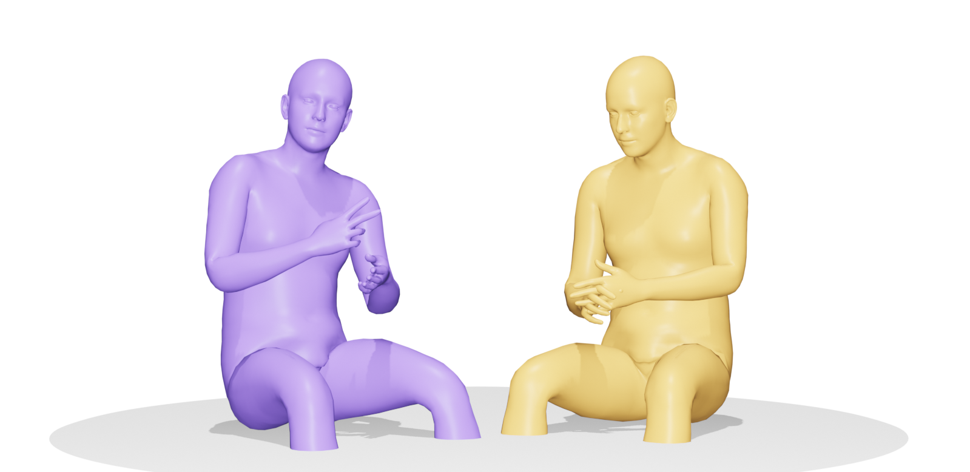
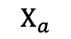
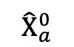
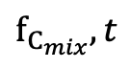
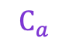
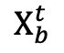
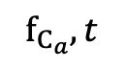
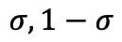
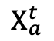
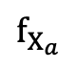
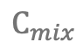
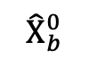
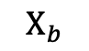
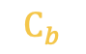
$$Χ_{a}$$
$$Χ_{a}^{t}$$
✕ num of blocks
$$C_{a}$$
TIM
Multi-head
Attention
+
・
$$f_{C_{a}}, t$$
$${\hat{Χ}}_{a}^{0}$$
Cross-Attn
$$C_{mix}$$
Audio Encoder
Motion Encoder
Motion Decoder
$$f_{Χ_{a}}$$
+
$$σ, 1−σ$$
+
+
$${\hat{Χ}}_{b}^{0}$$
Cross-Attn
$$C_{b}$$
$$f_{C_{mix}}, t$$
・
TIM
Multi-head
Attention
+
Temporal Interaction Module (TIM)
$$Χ_{b}$$
$$Χ_{b}^{t}$$
✕ num of blocks
Mutual Attention
・
Dot Product
Addition
TIM
Temporal Interaction Module
+
Matmul
+

Slide 3
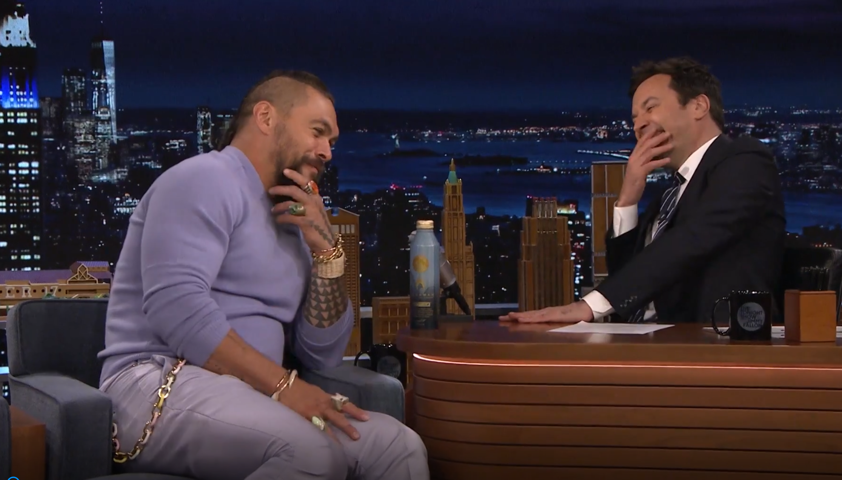
Mixed Audio
Separated Audio
Back then, this was the hot new thing everyone was betting on.
Cash was flooding in left and right.
SPEAKER A
Separation
SPEAKER B
That's true.

Slide 4

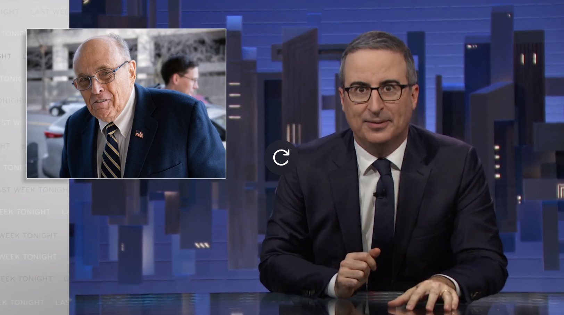
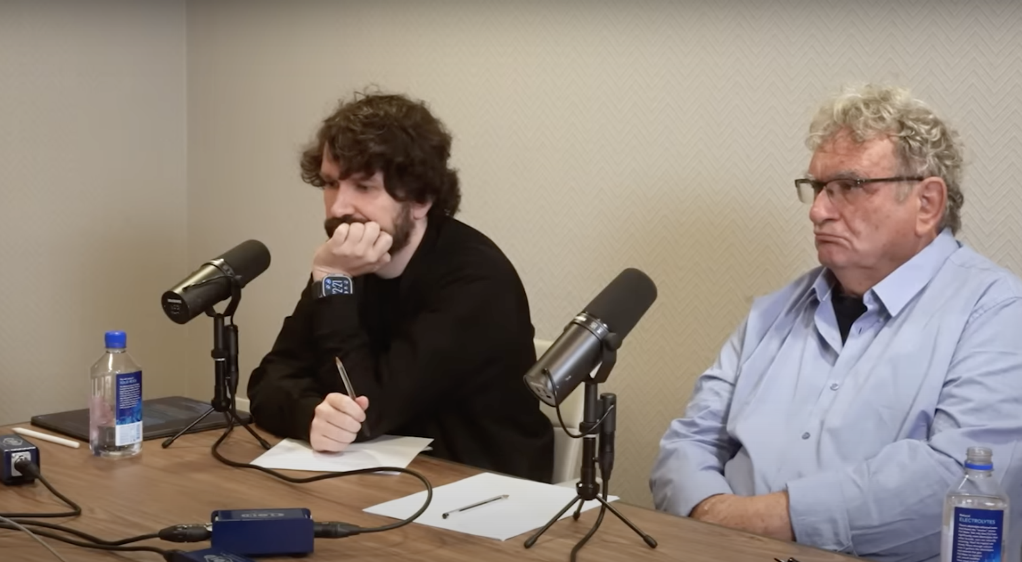
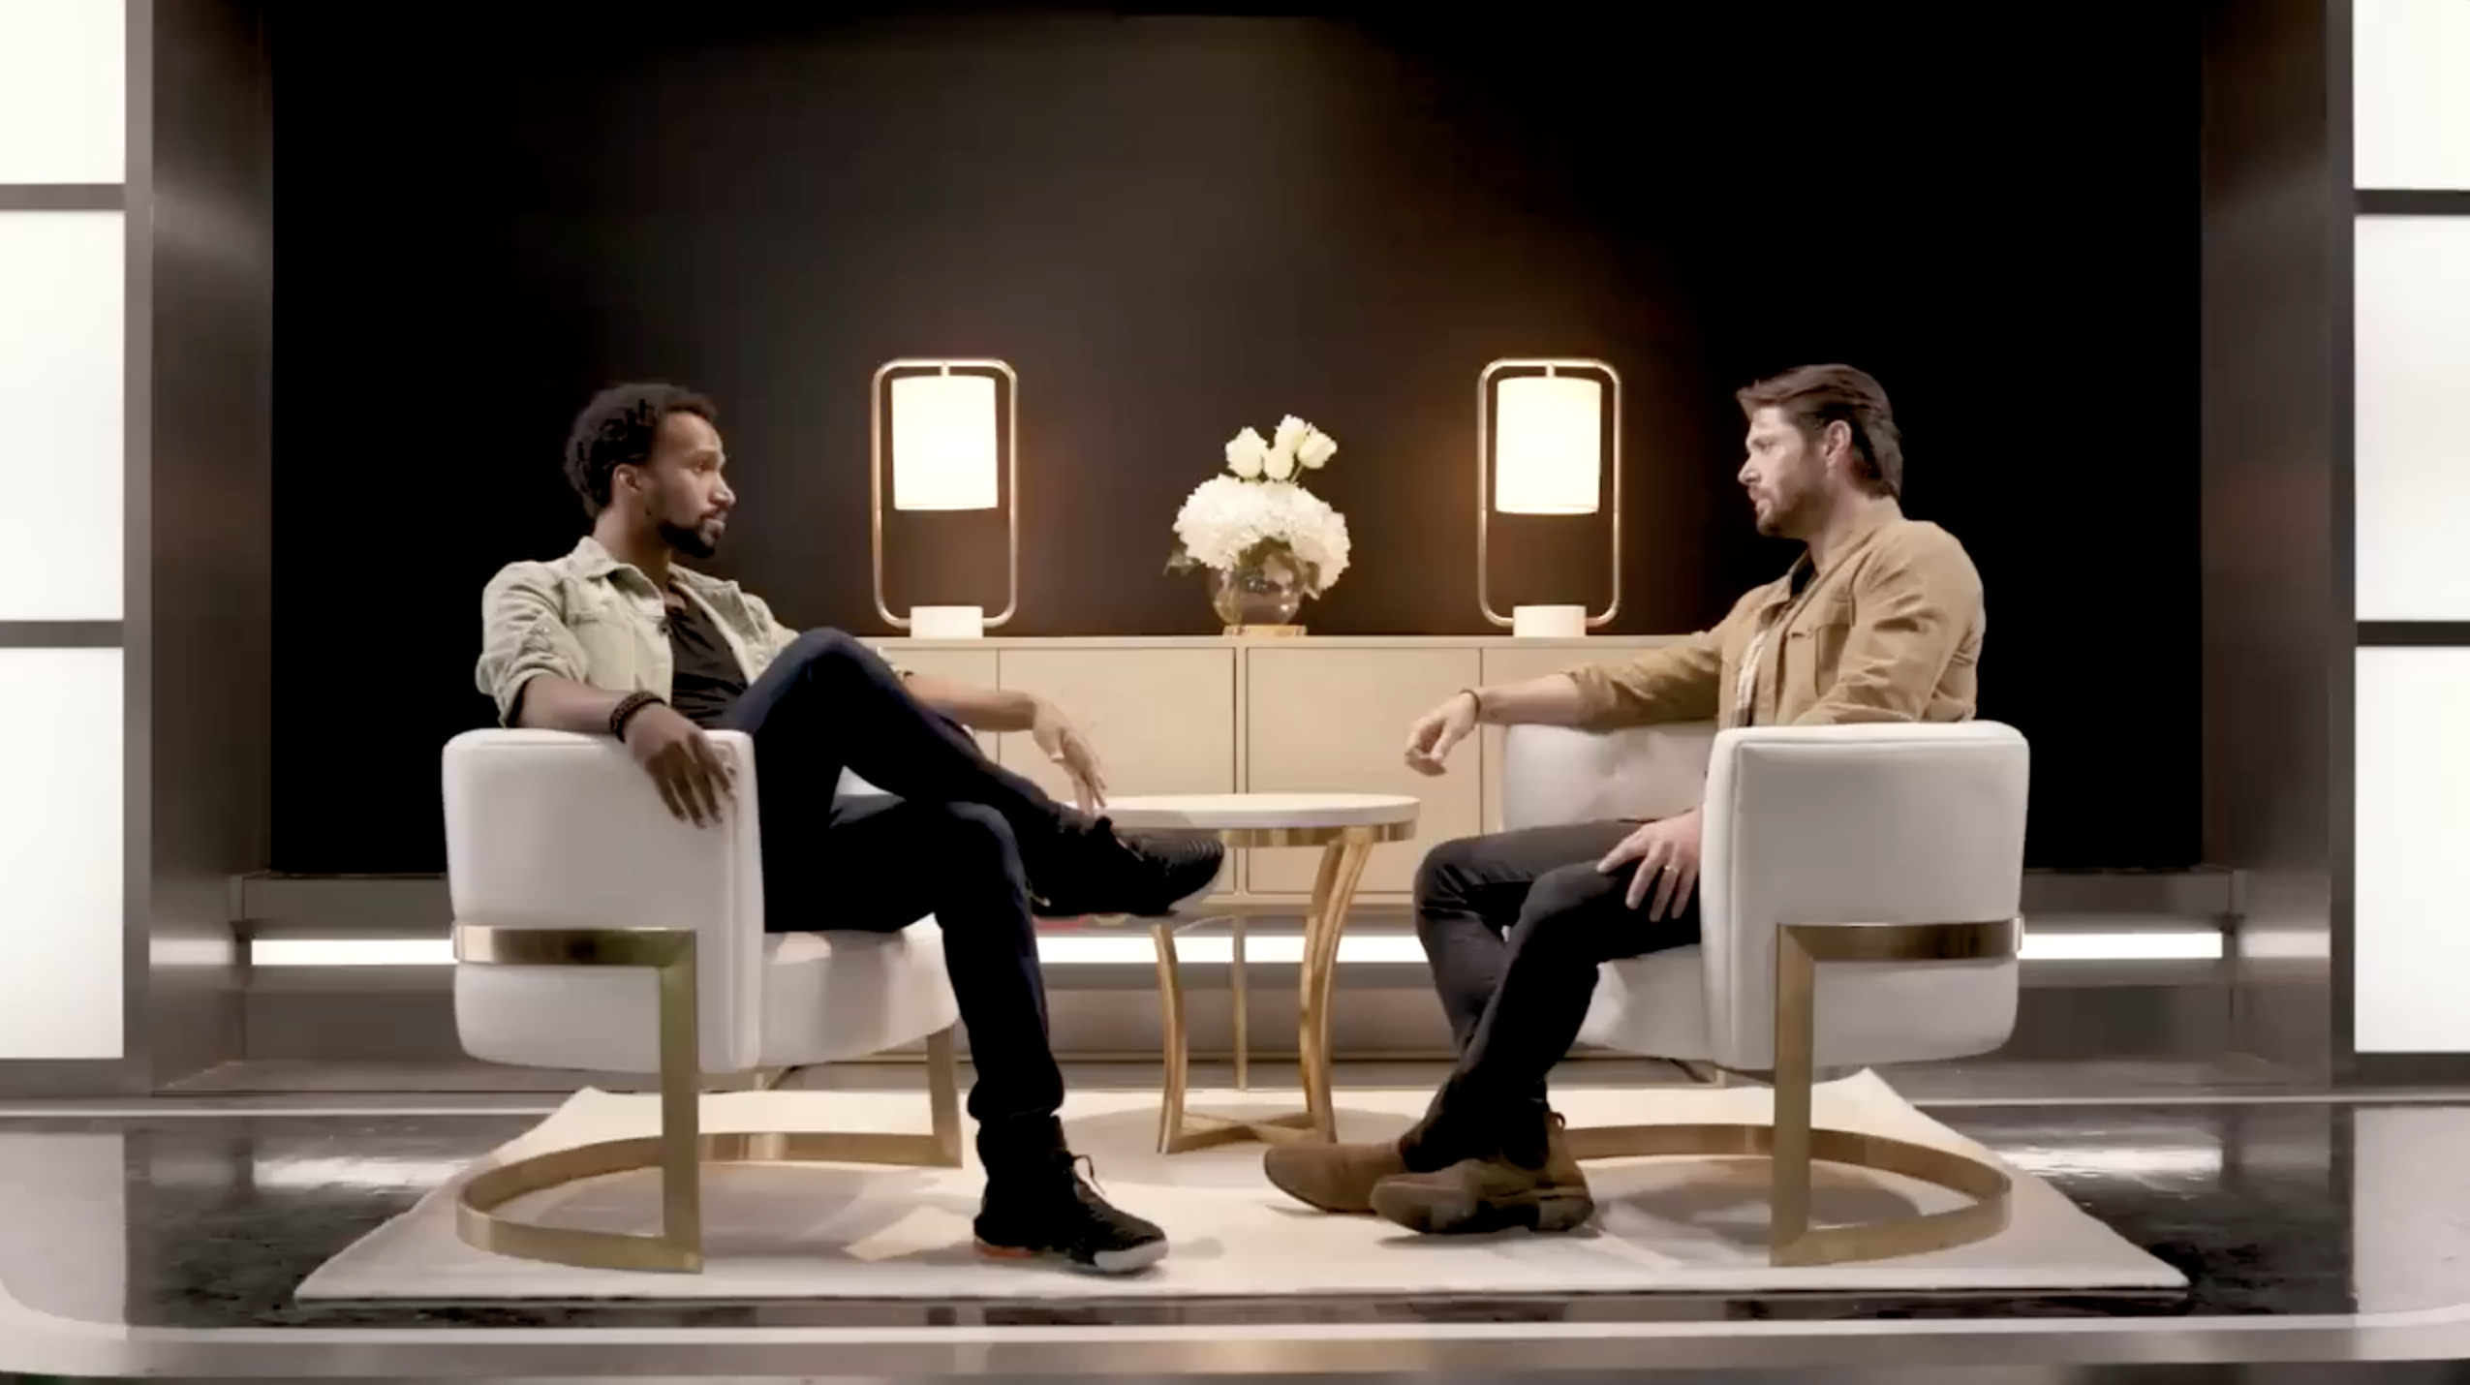

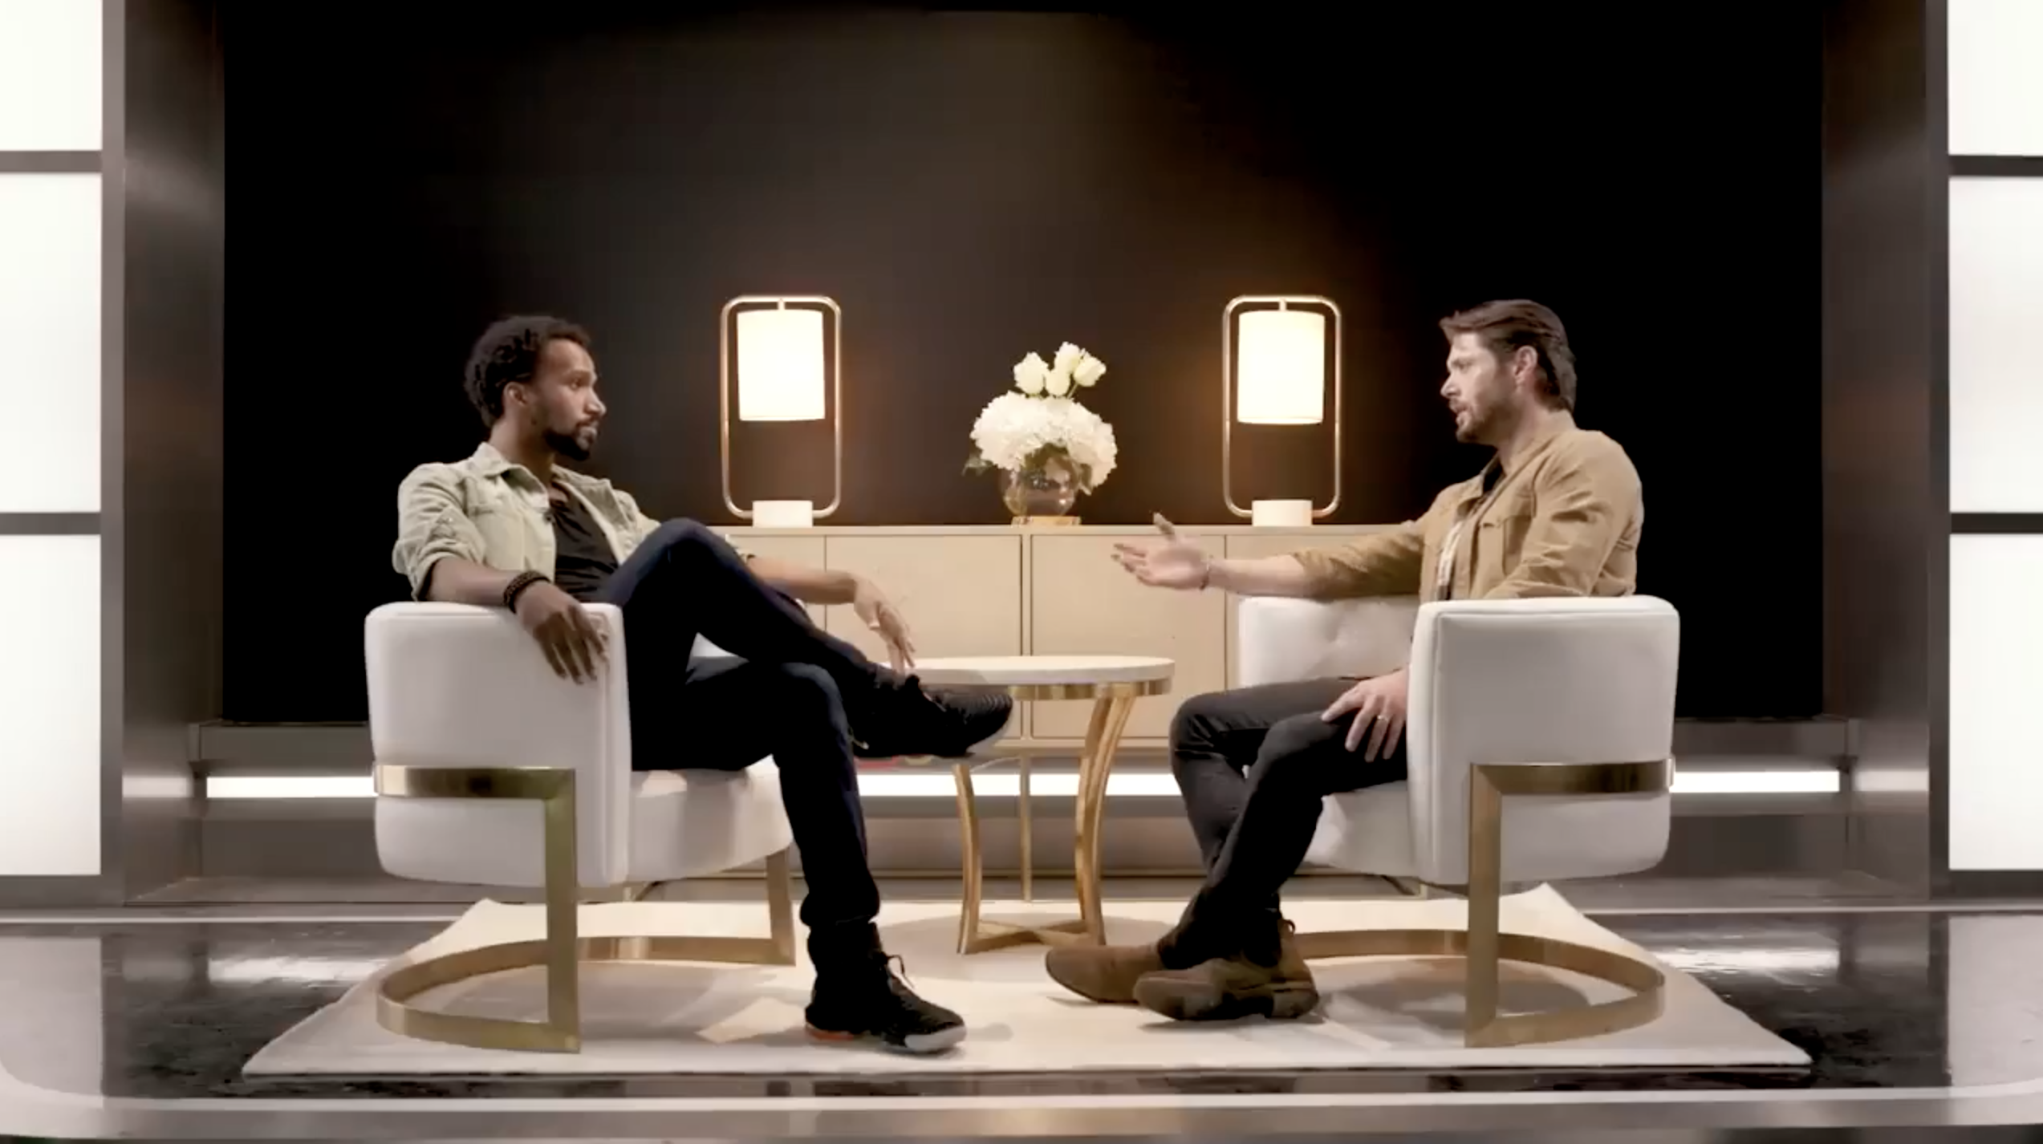
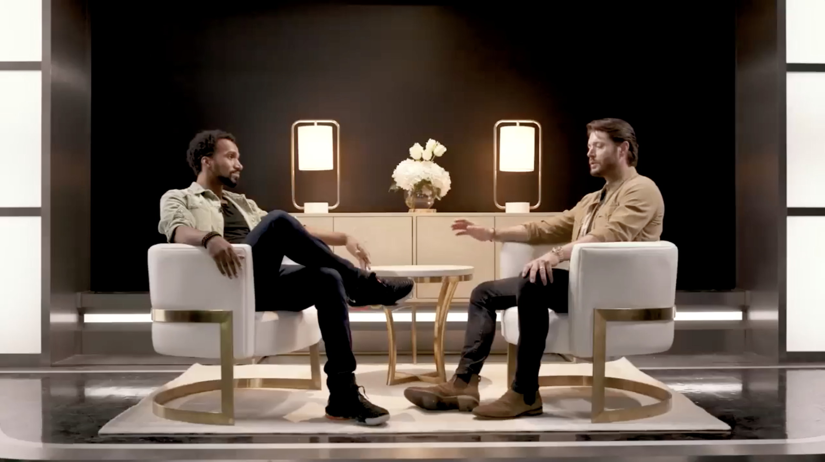
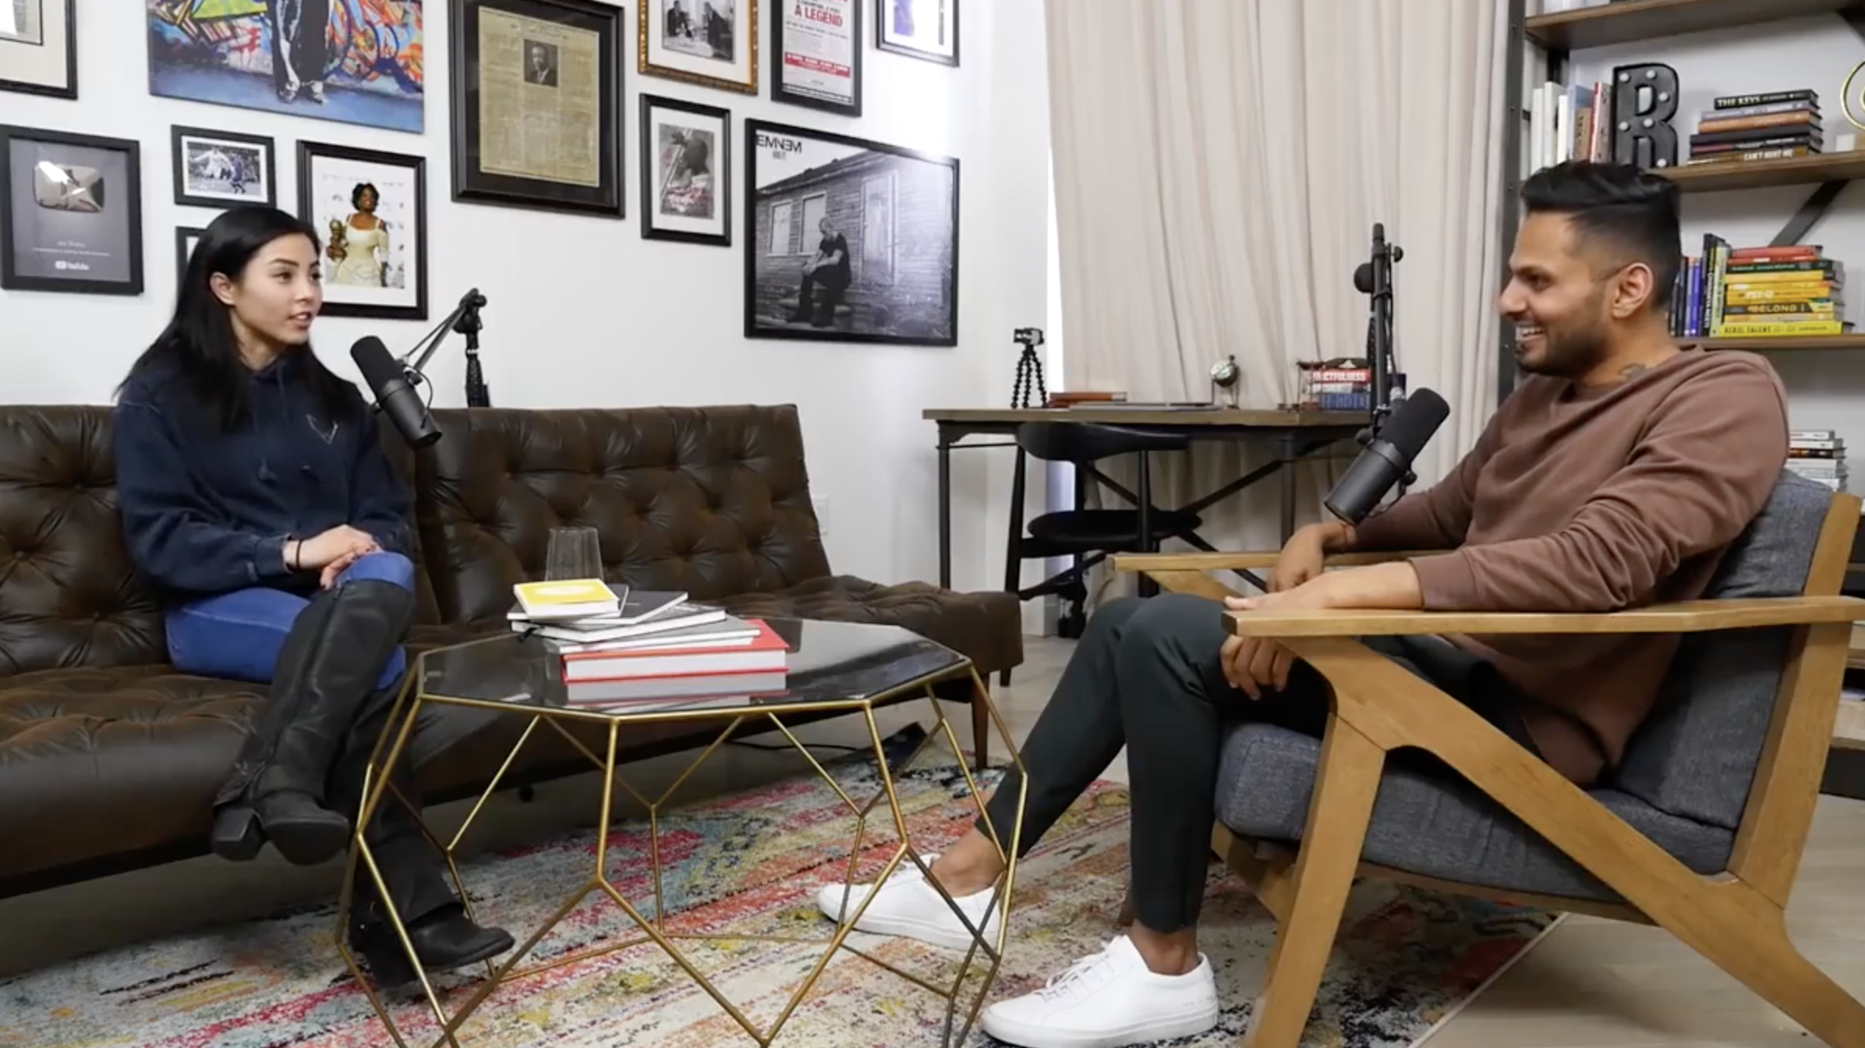
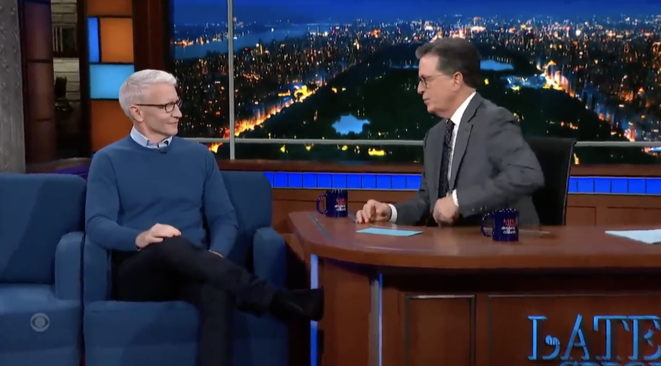
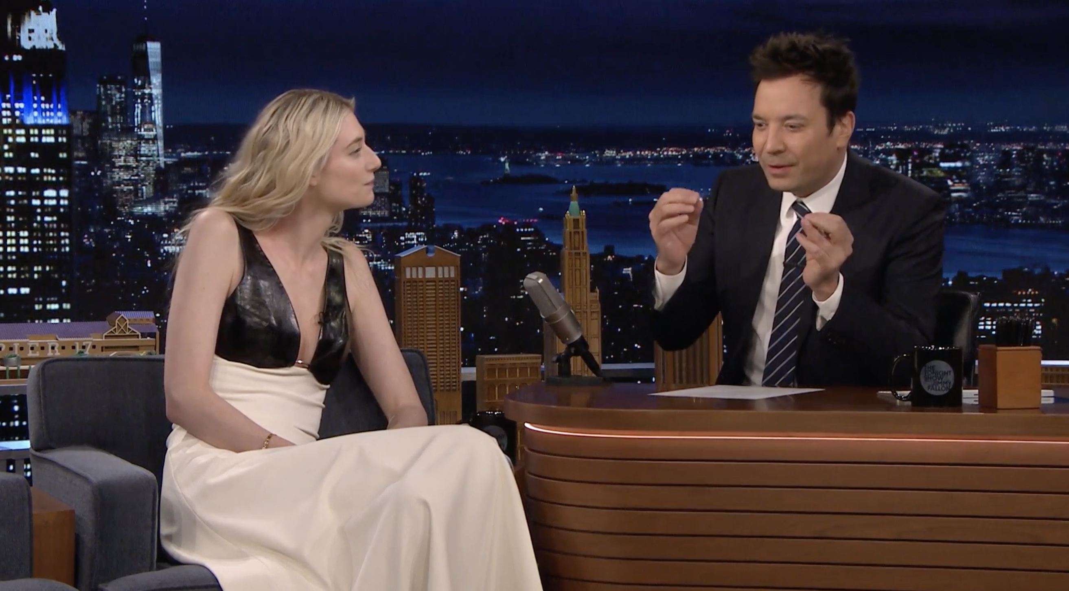
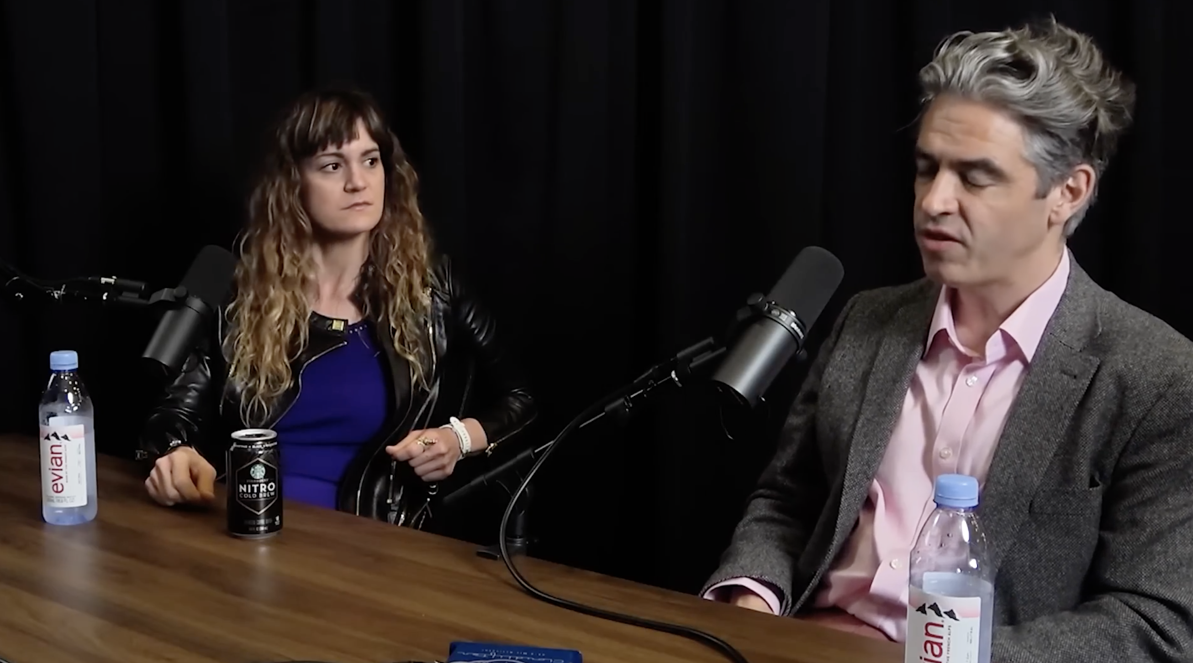
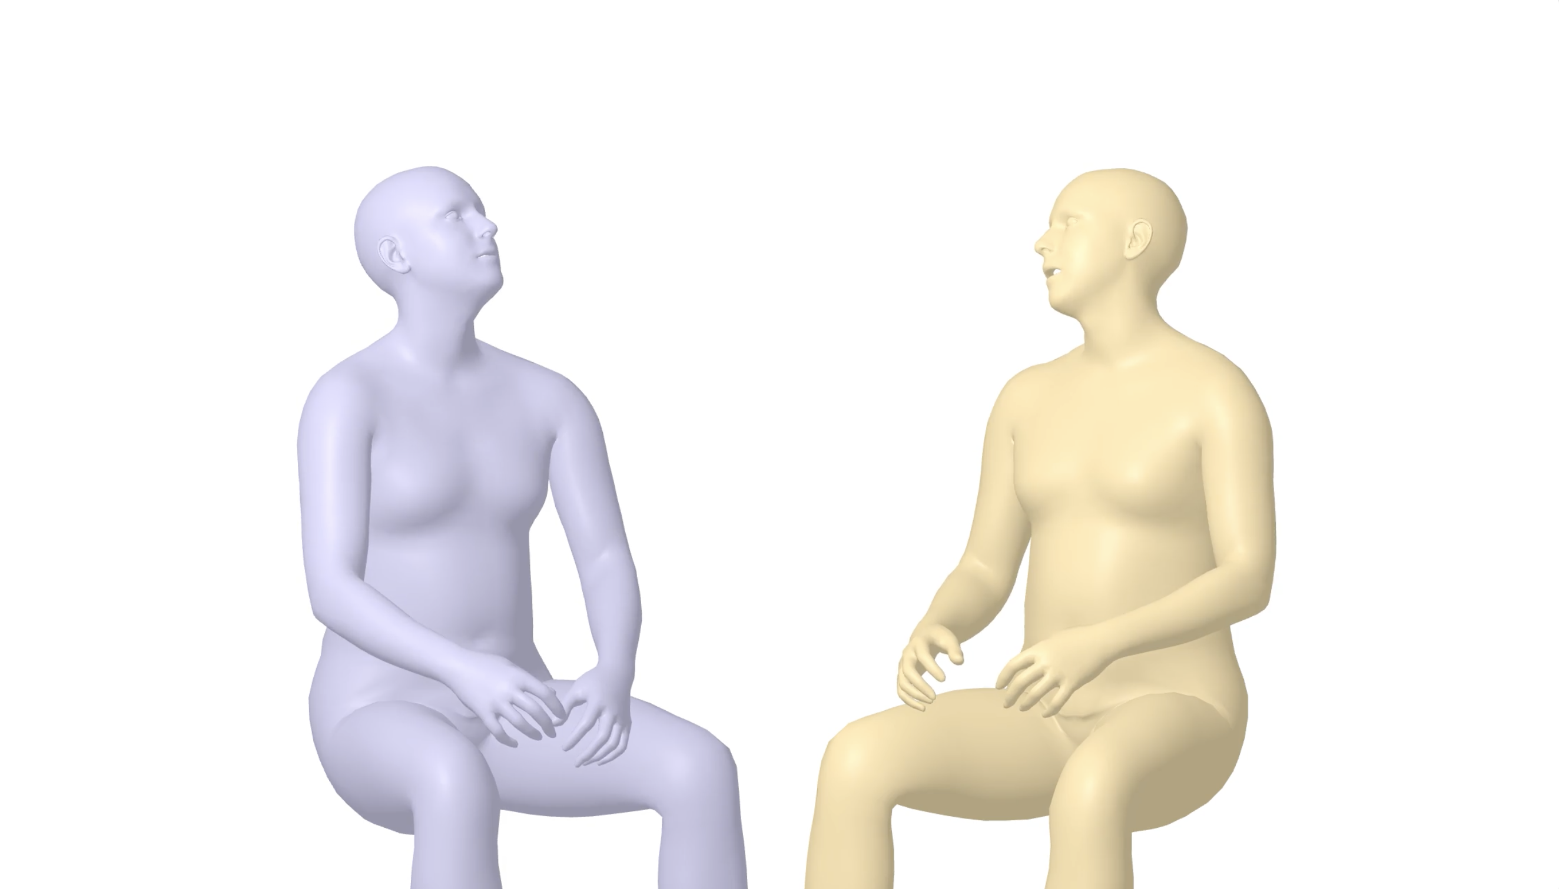
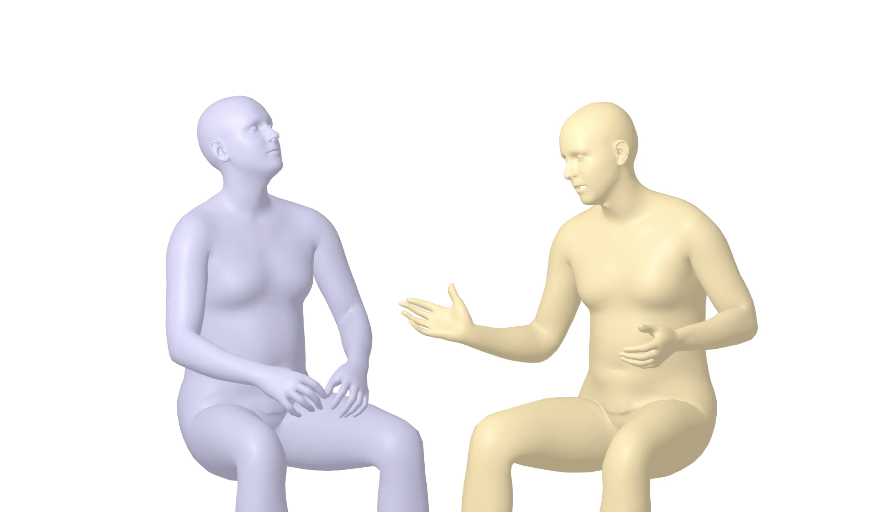
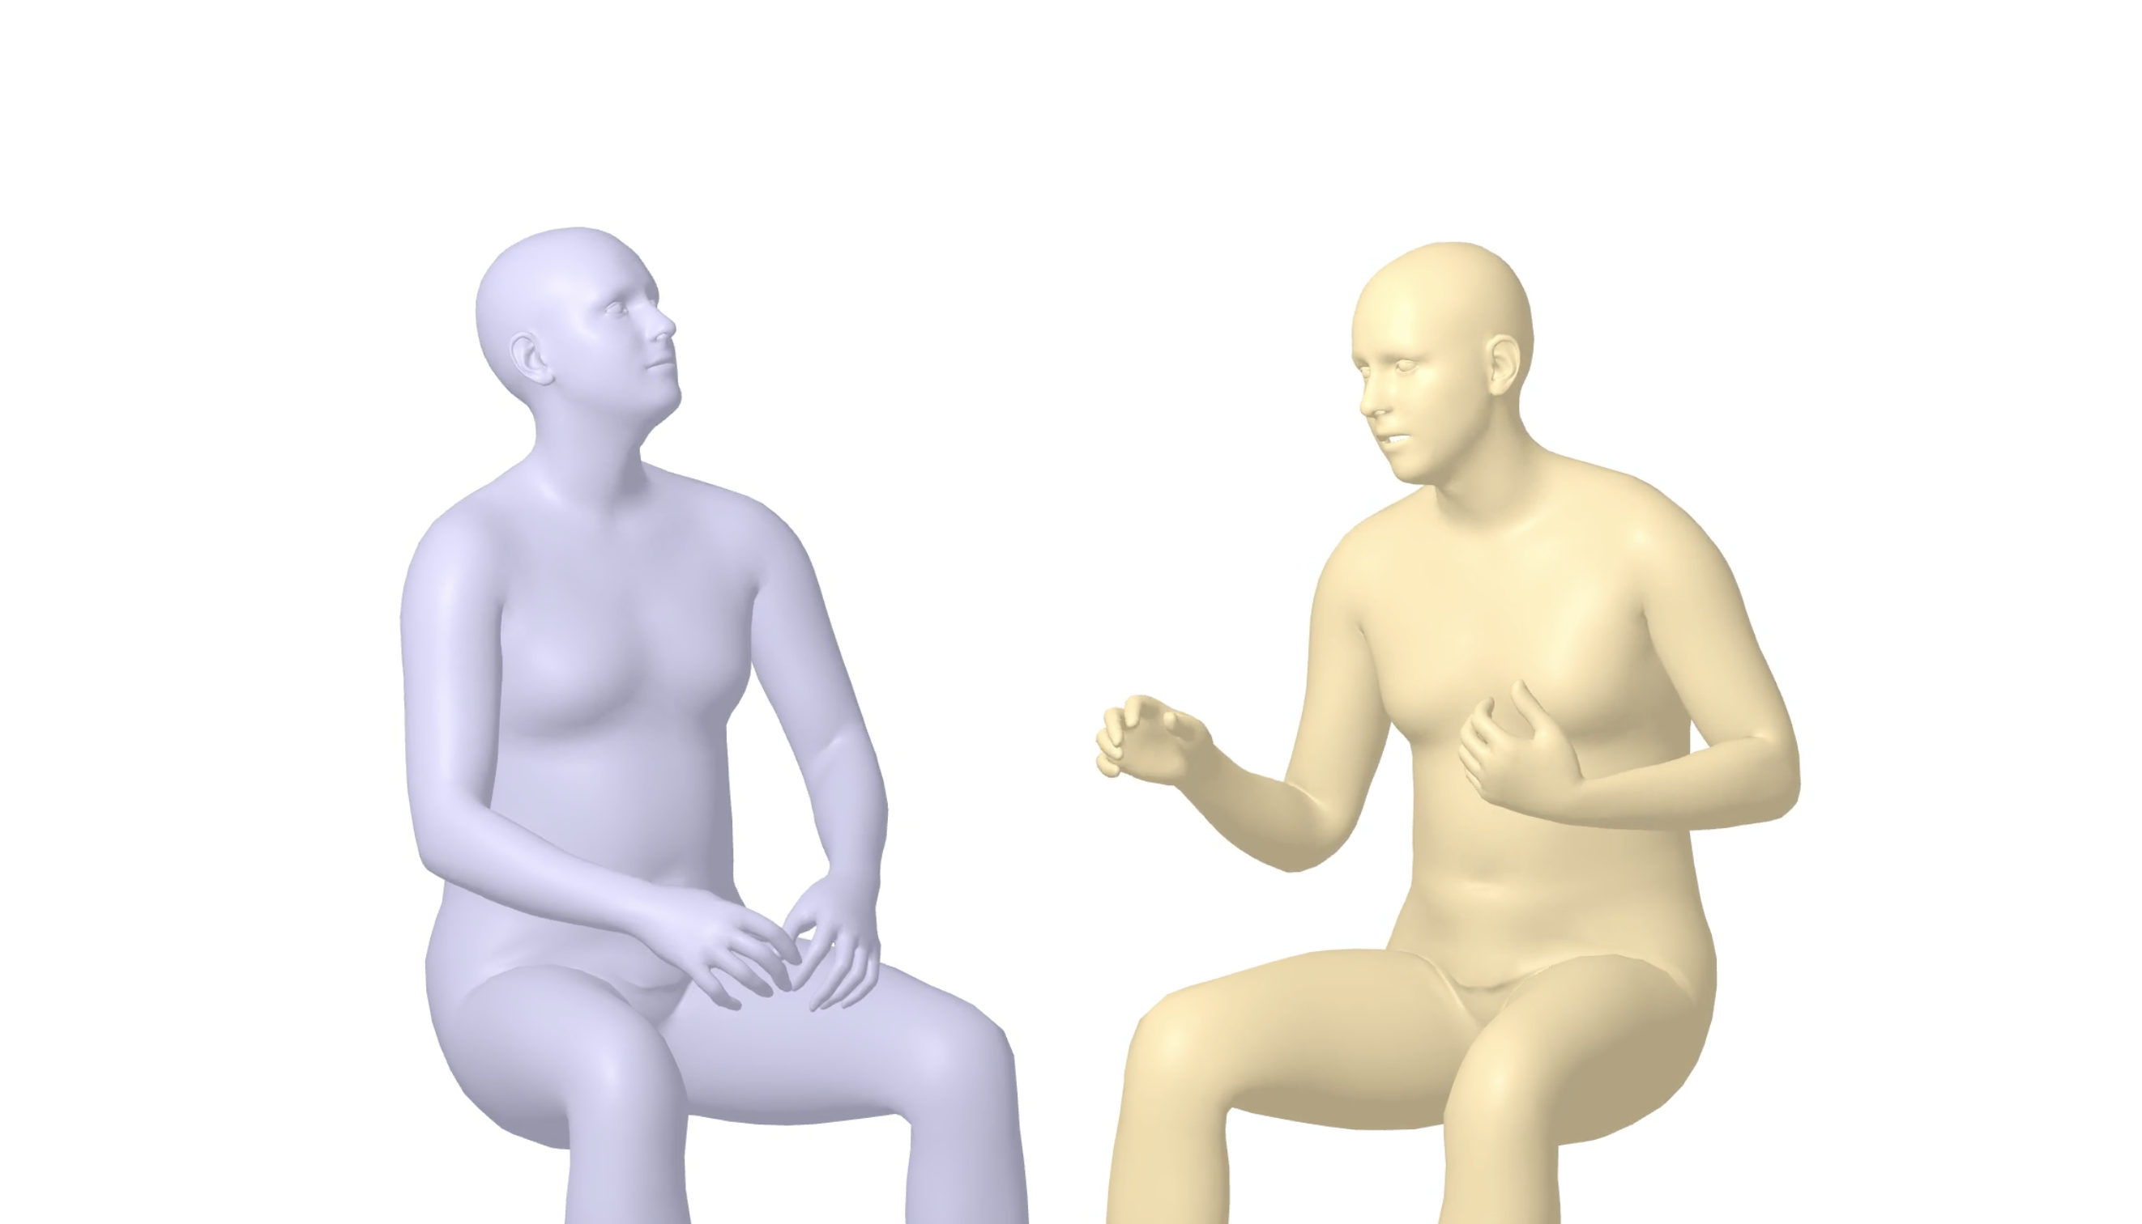
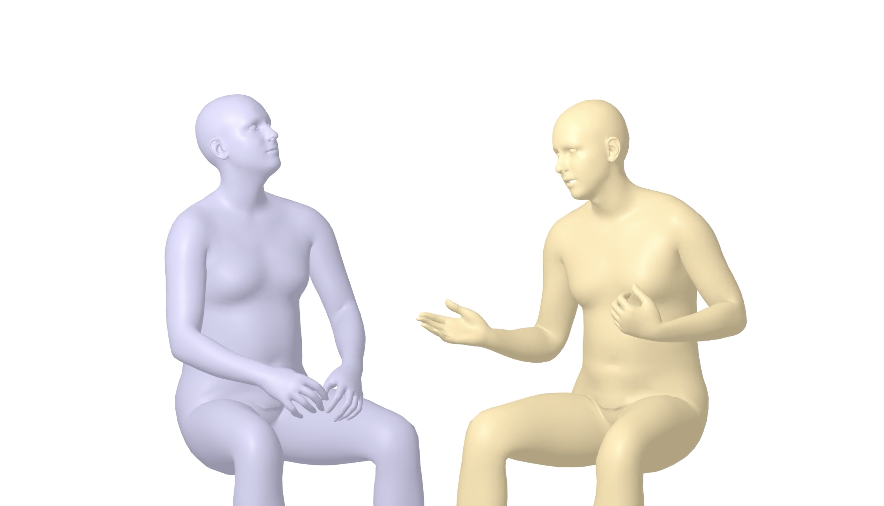
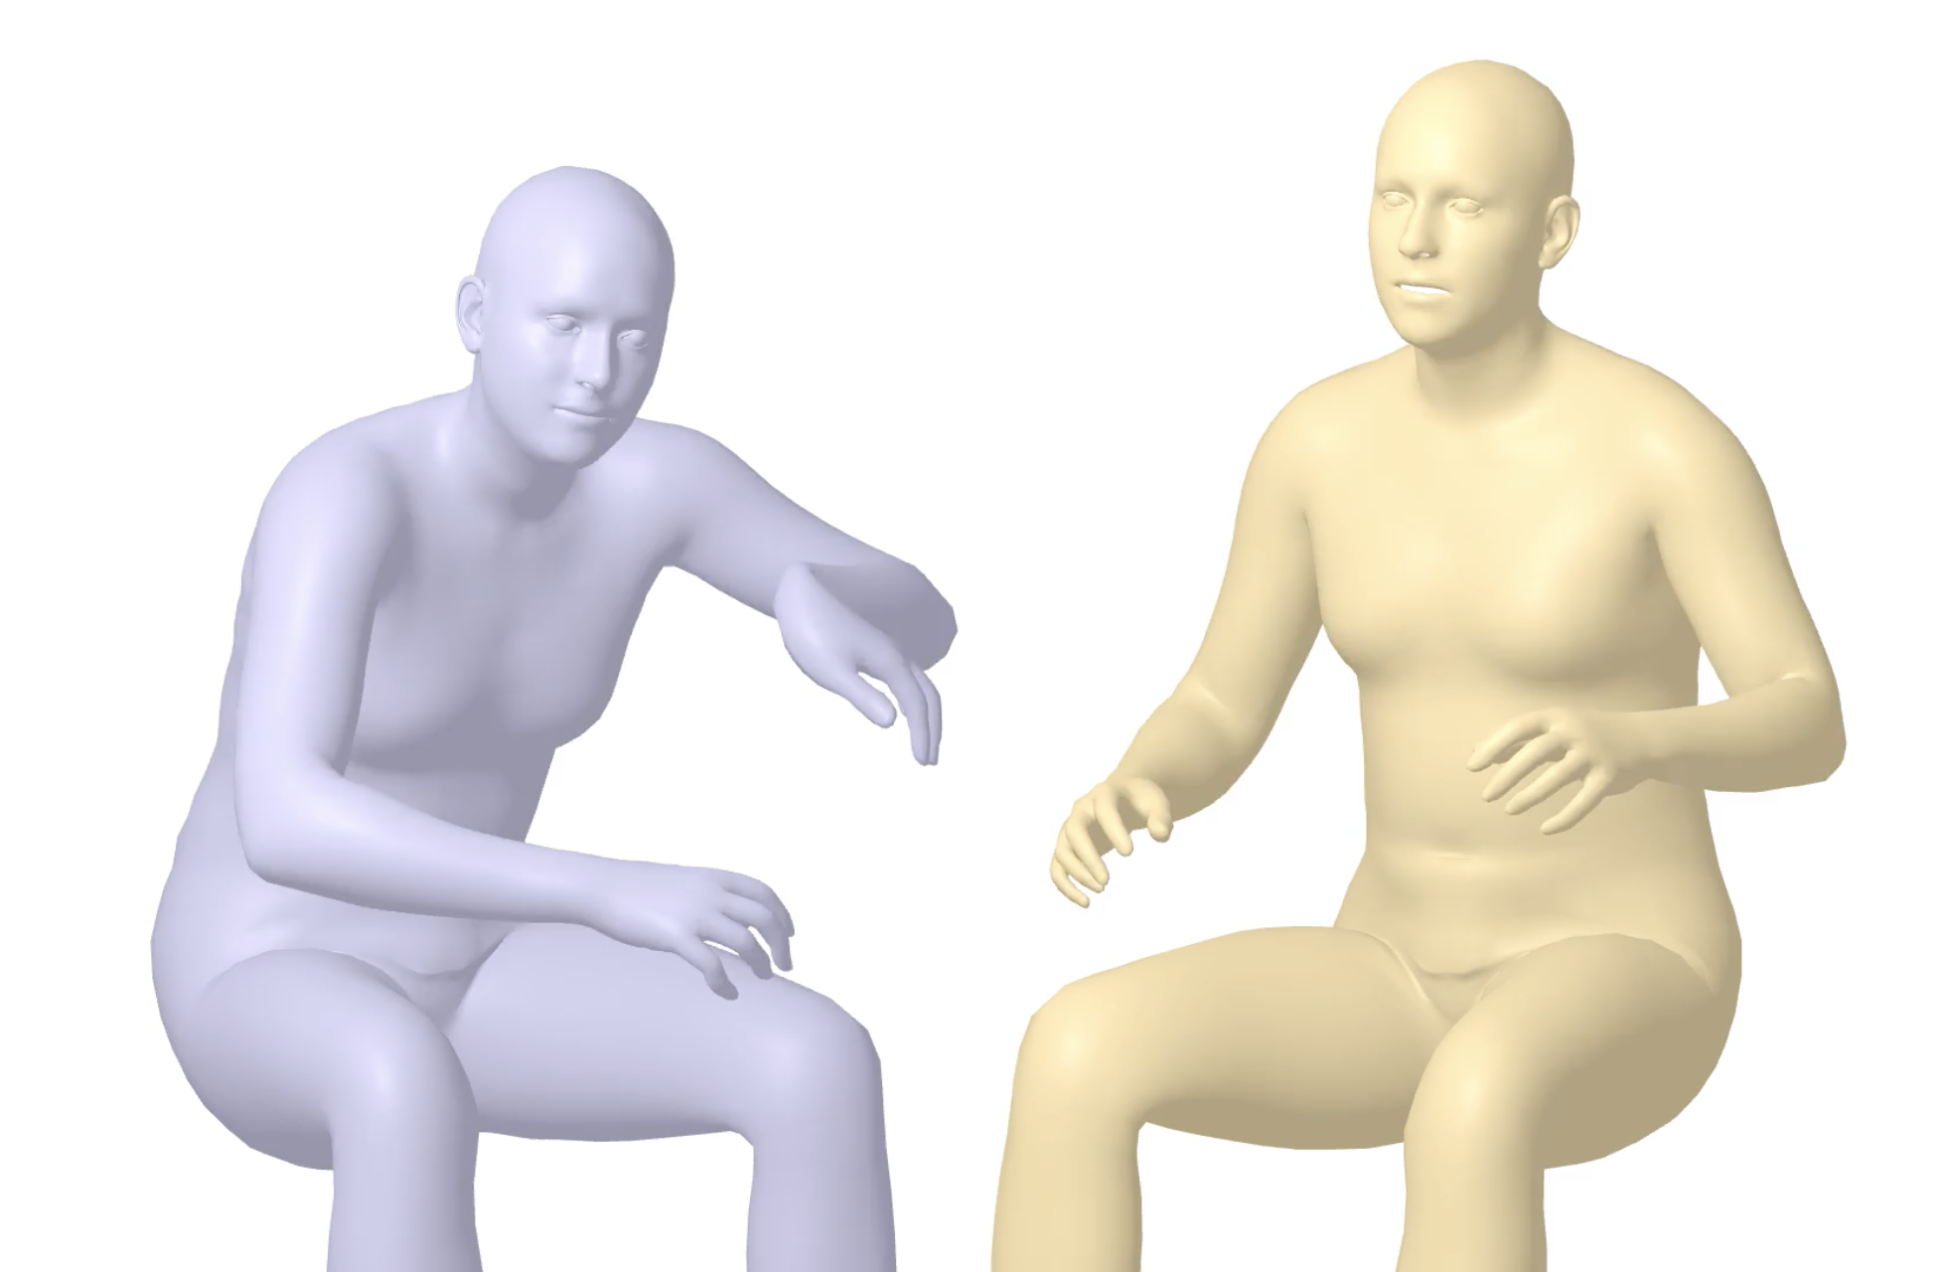
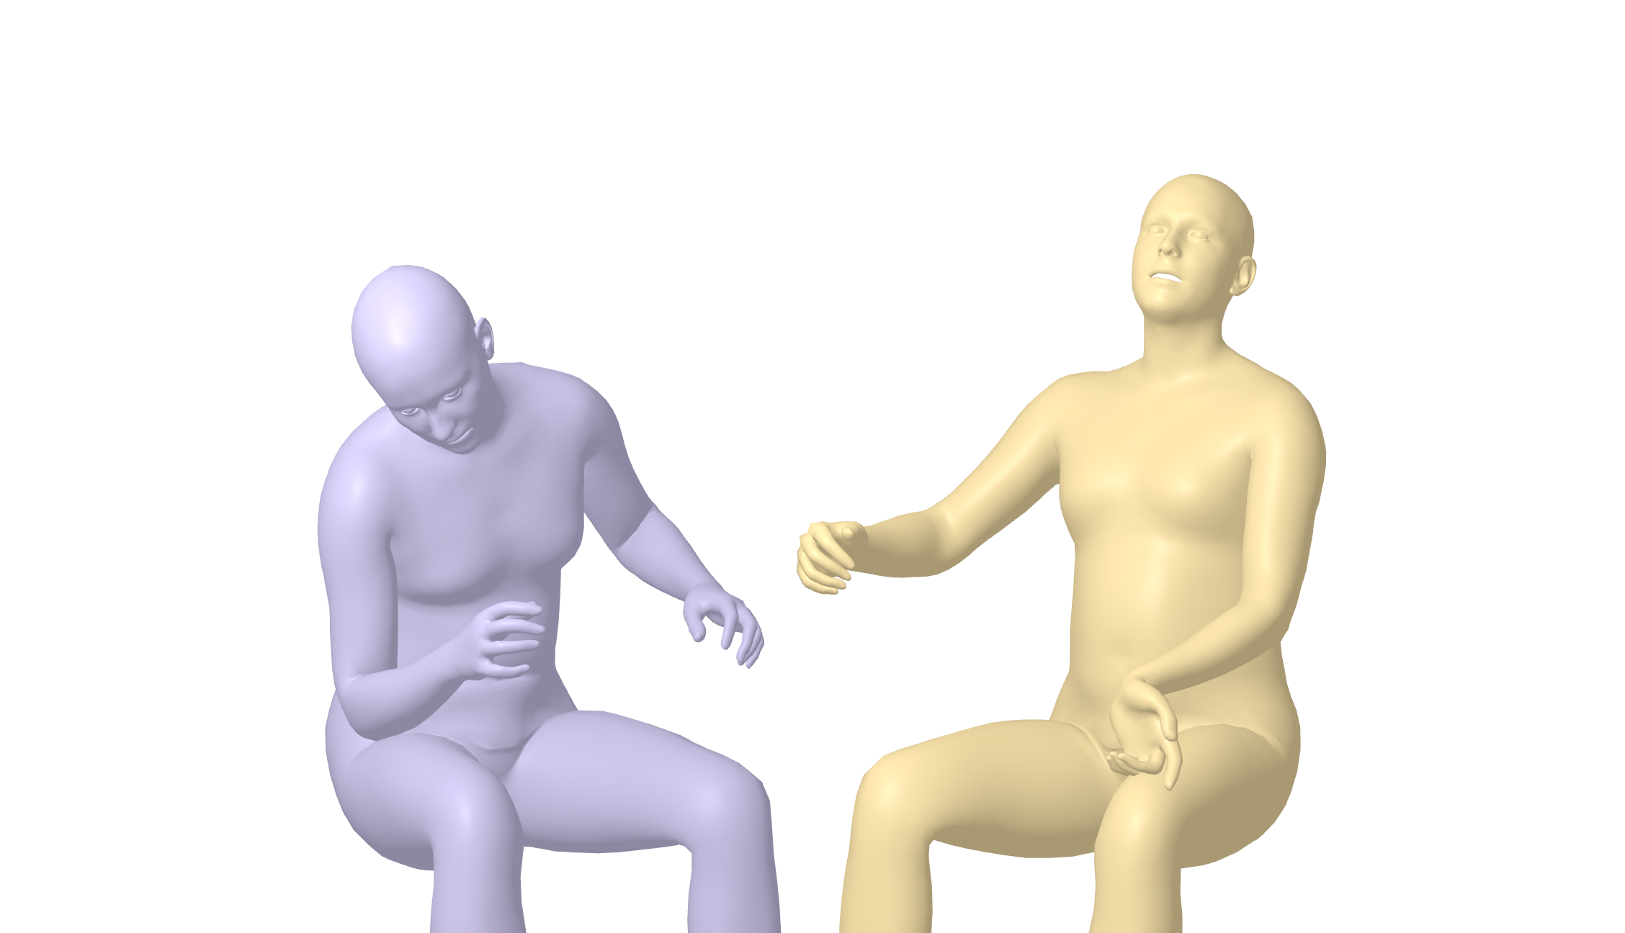

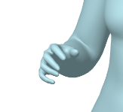
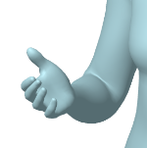
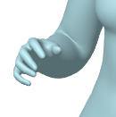
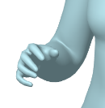
Automatic Processing
Manual Processing
Step 1. Conversational Video Collection
Step 4. Audio Extraction
Step 7. Pose Estimation
Step 10. Video Filtering
FFmpeg
PyMAF-X
❌ Non-conversational
❌ Dual-person shots with external voice
14 K Videos Collected
Step 5. Speech Recognition &
Speaker Diarization
Step 11. Pose Filtering
Step 2. Basic Filtering
Step 8. Pose Filtering
Raw Videos
Category-based filtering
Resolution ≥ 480p
Language: English
Text: “When we were kids, it’s all animation.” “There’s one thing I really love about…”
Timestamp:“start”: 0.15, “end”: 1.805; "start": 2.315,"end": 2.99
Speaker: “SPEAKER_00”, …
Poses
Only two people
No speaker looking back
No missing joint of the upper body
Appropriately-sized speakers
Relatively noticeable gesture without change of the speaker positions
❌ Jittery…
Filtering Rules
pyannote-audio
❌ Unnatural
❌ Unnatural
WhisperX
Step 12. Audio&Speaker Alignment
Filtering Rules
Step 3. Scene Cut
Text | Timestamps | Speaker
“When we were kids, it’s all animation.” | “start”: 0.15, “end”: 1.805 | “SPEAKER_00”
“There’s one thing I really love about…” | "start": 2.315, "end": 2.99 | “SPEAKER_01”
…
🎬 PySceneDetect
Step 6. Audio Filtering
Step 9. Smoothing
Clips
Filtering Rules
Audios are too noisy
No word detected
SmoothNet
🖐️ 1. Manual Correction
“SPEAKER_00”
…
Audio Extraction and Filtering
Pose Estimation
and Filtering
🖐️ 2. Manual Alignment
Basic Video Processing
“SPEAKER_00” : right

Slide 5


